Slide 1
Computational & Data
Journalism
JOUR479V/779V – Computational Journalism
University of Maryland, College Park
Nick Diakopoulos, Ph.D.

Slide 2
Readings
What the Fox Knows
What value / advantages does data-driven journalism (DDJ) bring? What challenges does this pose?
Do you think “foxes” can do deep explanatory journalism?
Data Journalism Needs to Up Its Own Standards
Should data journalism be held to same standard as scientific inquiry?
What are some of the criticisms Cairo brings up?
Notes:
Advantages-> prediction, collecting / organizing, finding relationships, critique of stats, generalization
Challenges-> speed, accessibility
Foxes are broad; hedgehogs are deep. We need a lot of context in order to understand data, so can foxes really do deep explanatory journalism? Do we need to partner journalists with specialists?
Cairo’s criticisms-> can’t be cheap, fast, needs domain knowledge to interpret data correctly

Slide 3
Readings
Data Science Workflow
How does the workflow described here compare to the one that Nate Silver describes?
Computational Journalism
Do you think the technical challenges laid out in the 2011 article are still relevant today? What’s new / different?
Besides investigative journalism, what are other areas of journalism where computation may play a role?
Notes:
Interesting that silver’s model doesn’t really consider dissemination. But also interesting that data science and data journalism share a lot in common
There’s been a lot of advance on things like audio / video indexing with things like Siri

Slide 4

Readings
Clarifying Journalism’s Quantitative Turn
Why are distinctions between terms like data journalism, computer-assisted journalism, and computational journalism important?
DDJ
CJ
CAR

Slide 5
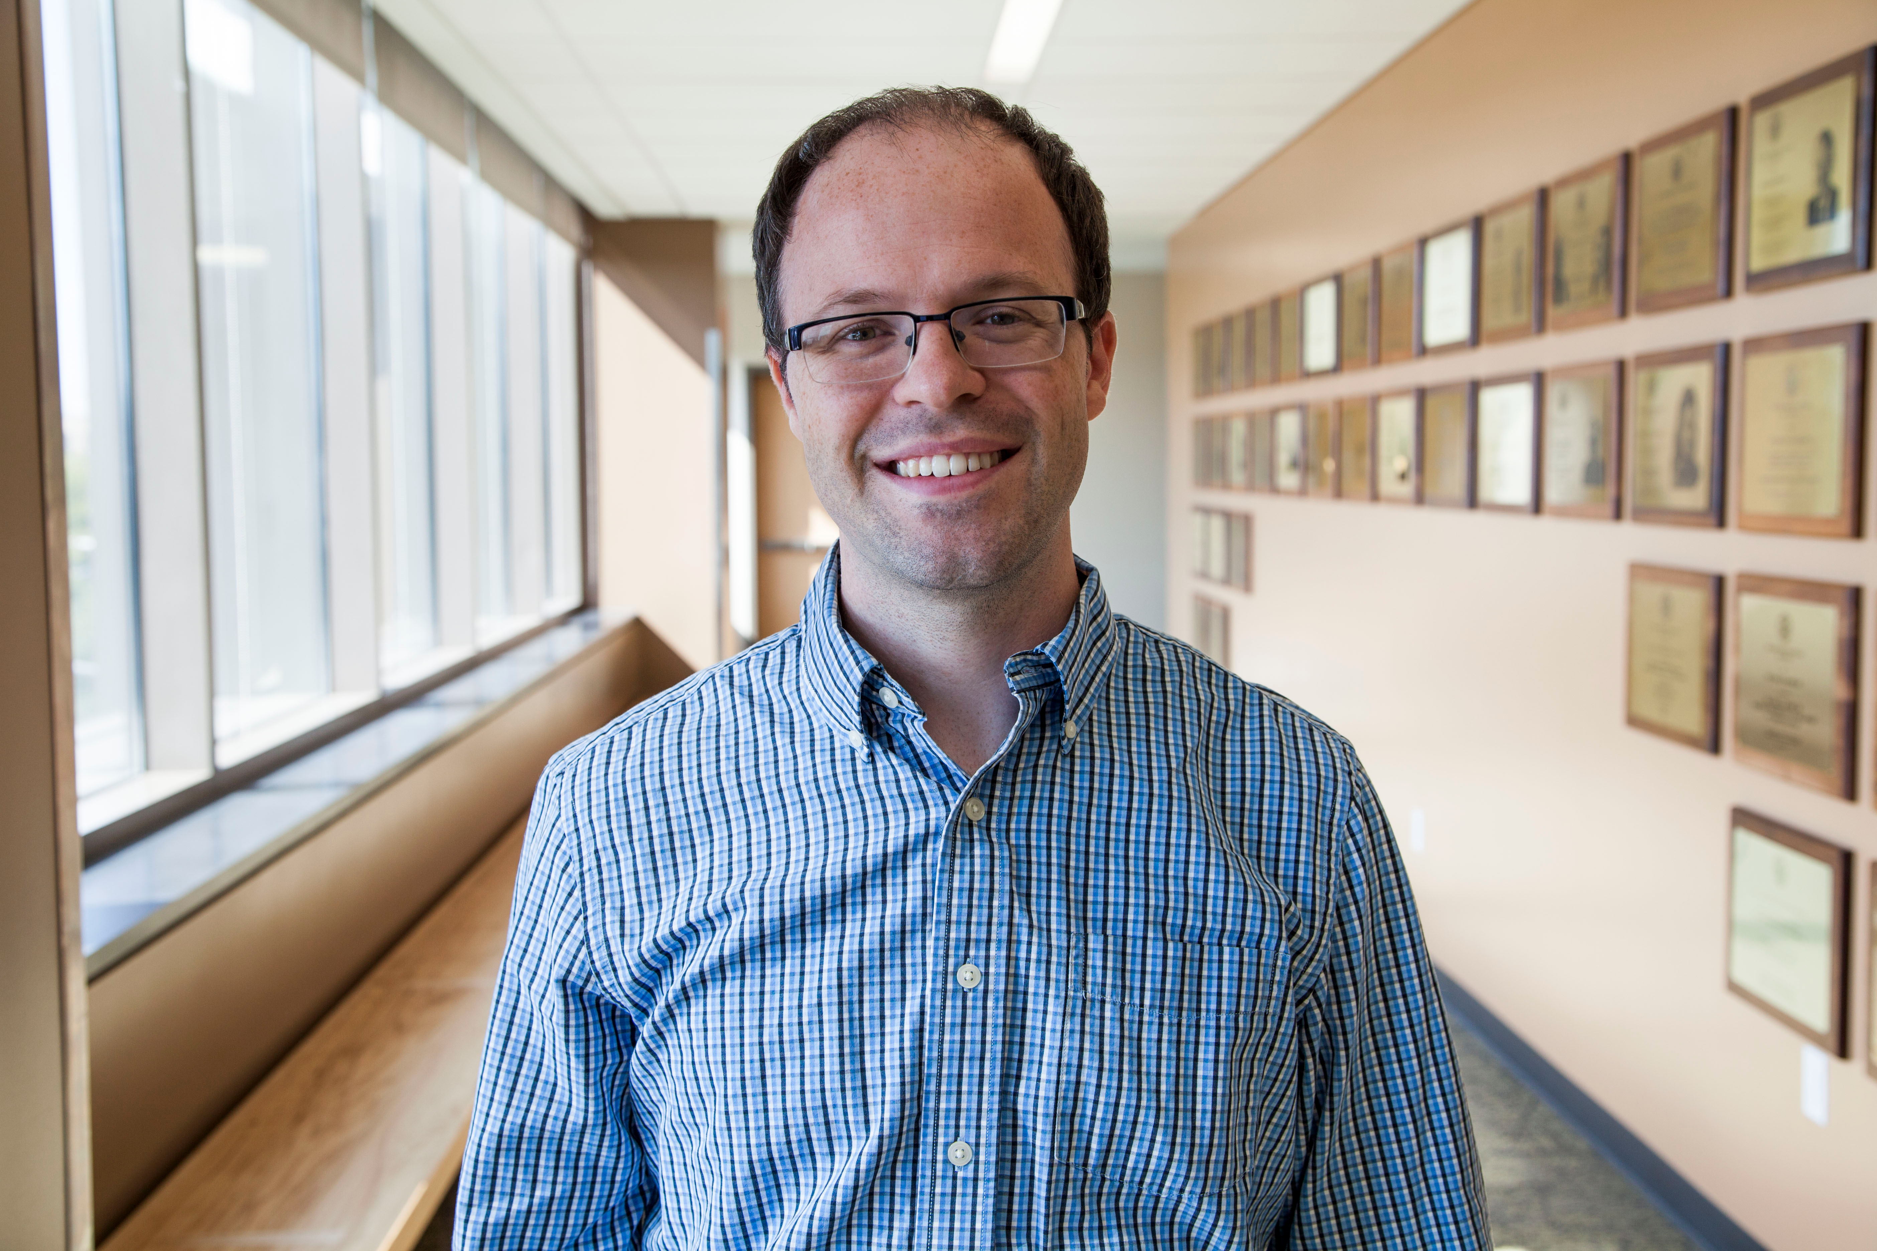
“CAR is rooted in social science methods and the deliberate style and public-affairs orientation of investigative journalism, data journalism is characterized by its participatory openness and cross-field hybridity, and computational journalism is focused on the application of the processes of abstraction and automation
to information.”
– Mark Coddington, Washington and Lee University
Notes:
Jeannette Wing is an important figure when it comes to the idea of computational thinking. This is how she defines it.

Slide 6
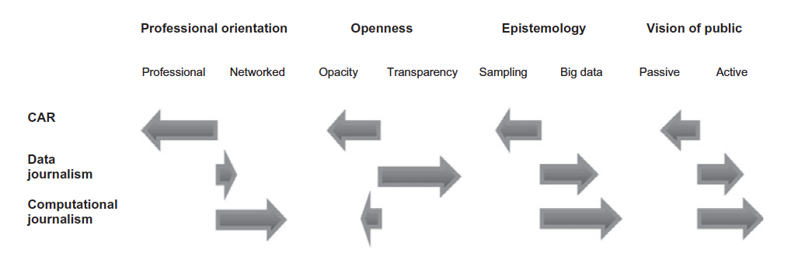
Notes:
Coddington delineates 4 dimensions along which the three types of journalism vary.

Slide 7
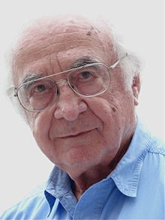
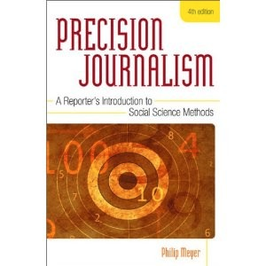
Computer-Assisted Reporting (CAR)
Grew out of Philip Meyer’s notion of Precision Journalism (also a book in 1973)
Notes:
We have a CAR course at UMD, it’s JOUR 772. CAR is quite old and itself grew out of something called Precision Journalism.
CAR is based on making journalism more of a social science. Using methods such as surveys and statistical analysis to test hypotheses. In it’s modern day usage I associate it with things like using FOIA to get at governmental databases.

Slide 8
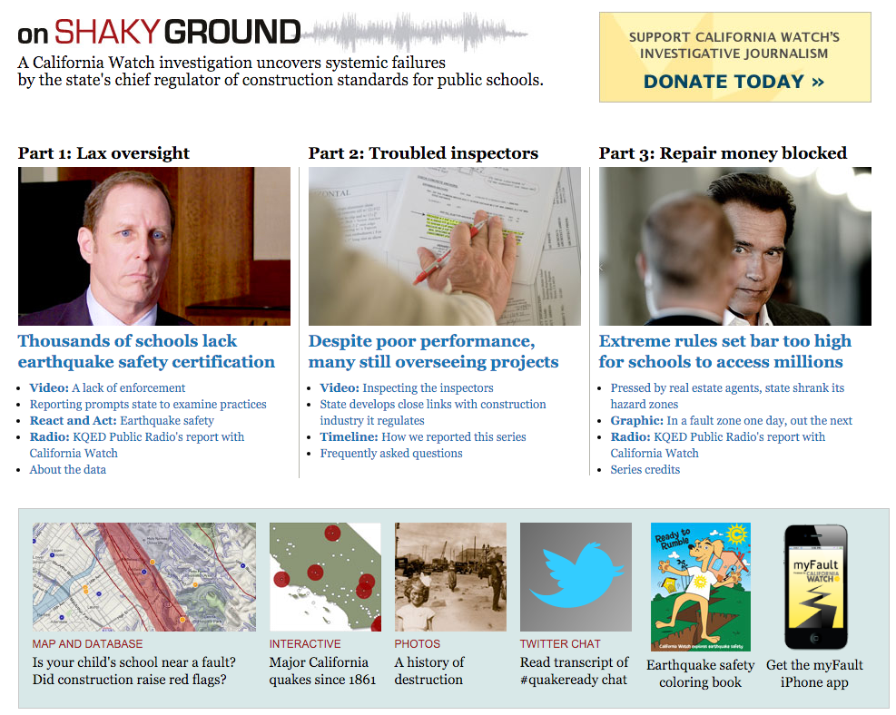
http://californiawatch.org/earthquakes
Notes:
Investigation began with spreadsheet of 9000 schools that didn’t comply with legal standards.
Much reporting was then done to improve the quality of this data, such as fixing inaccuracies in names and locations.
Hypothesis testing was used to identify whether state regulators has failed to enforce California's earthquake safety laws. Samples were taken to manually assess subsets of the data. They then used the database to find “examples” of cases to investigate further.
Not as transparent to the public: limited methods listed, no access to underlying data.

Slide 9
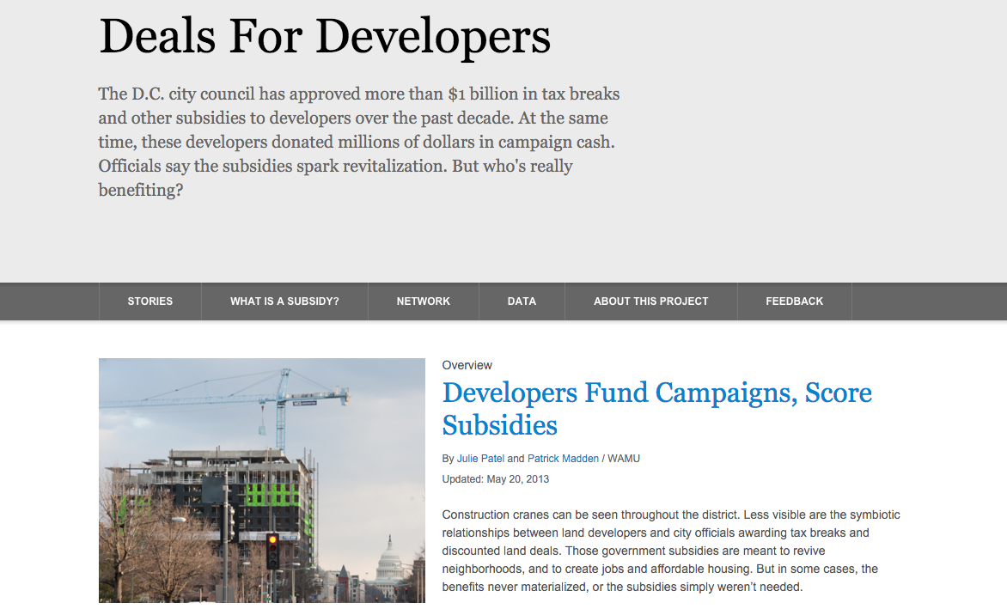
Data-Driven Journalism
http://apps.npr.org/deals-for-developers-wamu/
Notes:
Might refer to this as a news app. It’s got some key features that make it a good example of DDJ: it has interactive elements (the network), it publishes data directly on the page in a table for maximal transparency, but it also incorporates written story elements.

Slide 10
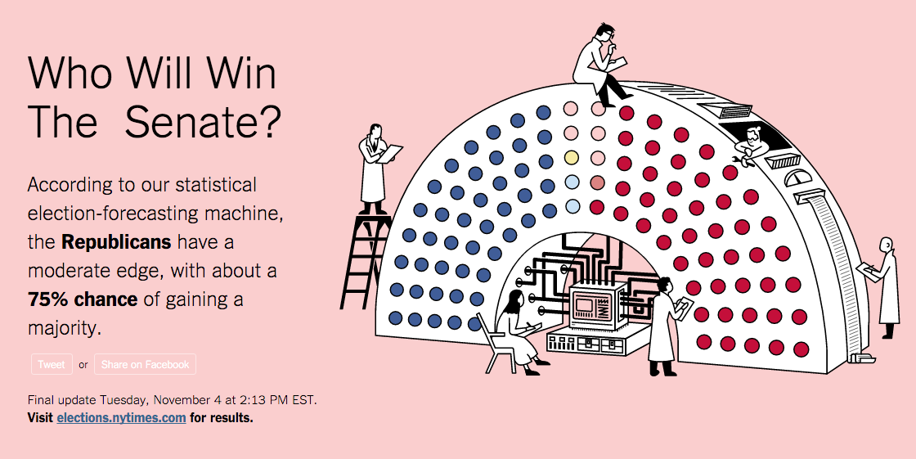
Computational Journalism
http://www.nytimes.com/newsgraphics/2014/senate-model/
Notes:
Simulation and prediction are important aspects of CJ. They do take a more active view of the audience by providing interactivity with these models, and I would say it’s also oriented towards impacting the public rather than towards policy makers, and they also make an effort towards transparency, my making the model source code open (https://github.com/TheUpshot/leo-senate-model),

Slide 11
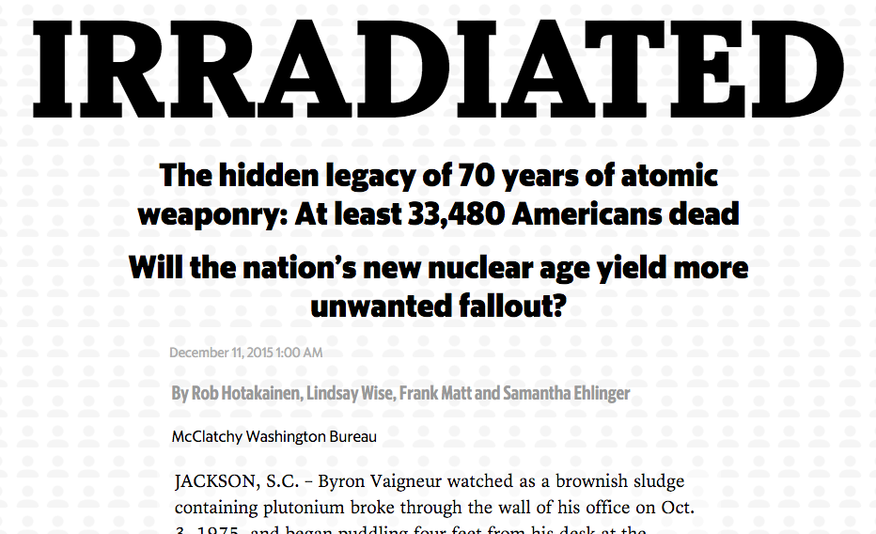
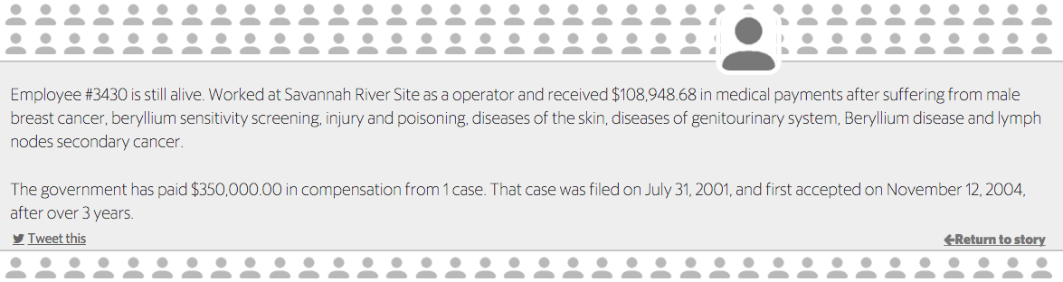
Computational Journalism
http://media.mcclatchydc.com/static/features/irradiated/#story
Notes:
Professional orientation seems more professional, it’s also not terribly transparent and isn’t interactive with the public. But it does deal with a slightly larger set of data, and it employs computing to output text for each case.
Actually I would probably say that this piece is done more along the traditions of CAR than CJ, but it points out that there is overlap between these different areas and a project is rarely distinctly one or the other.

Slide 12
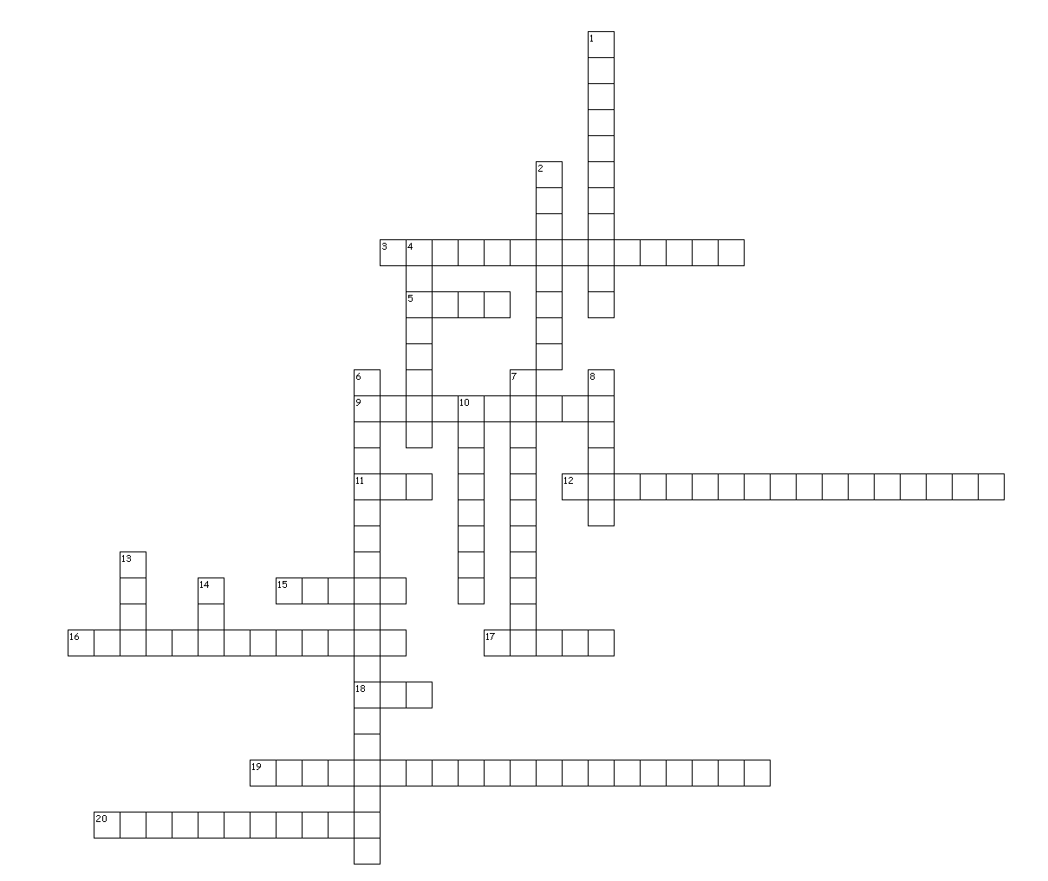
Data Journalism Puzzle
Notes:
Get in pairs and work for 20 minutes to solve this puzzle.

Slide 13
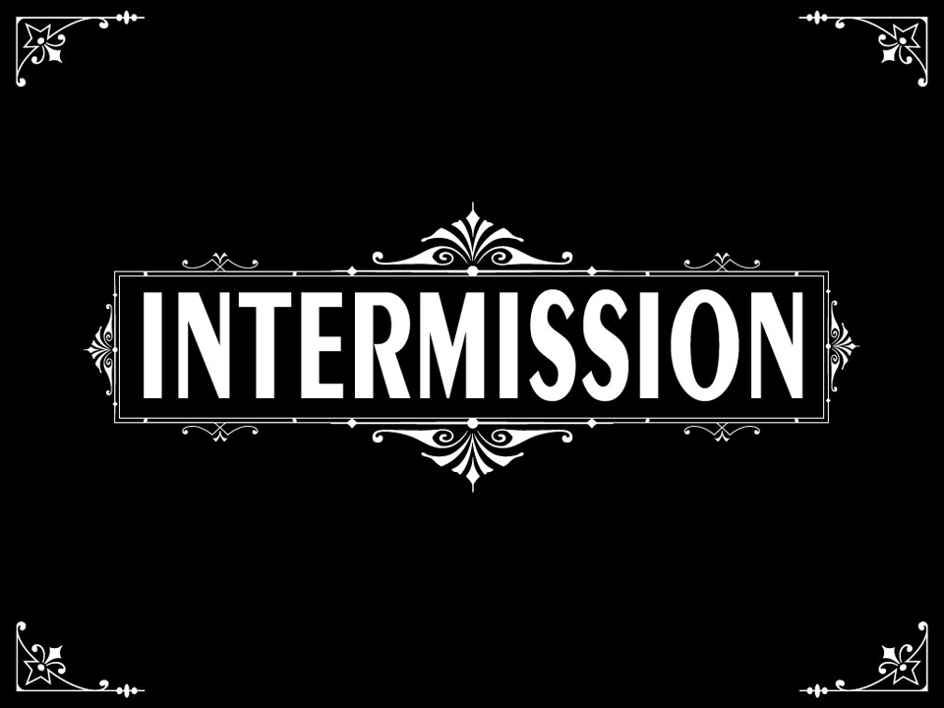

Slide 14
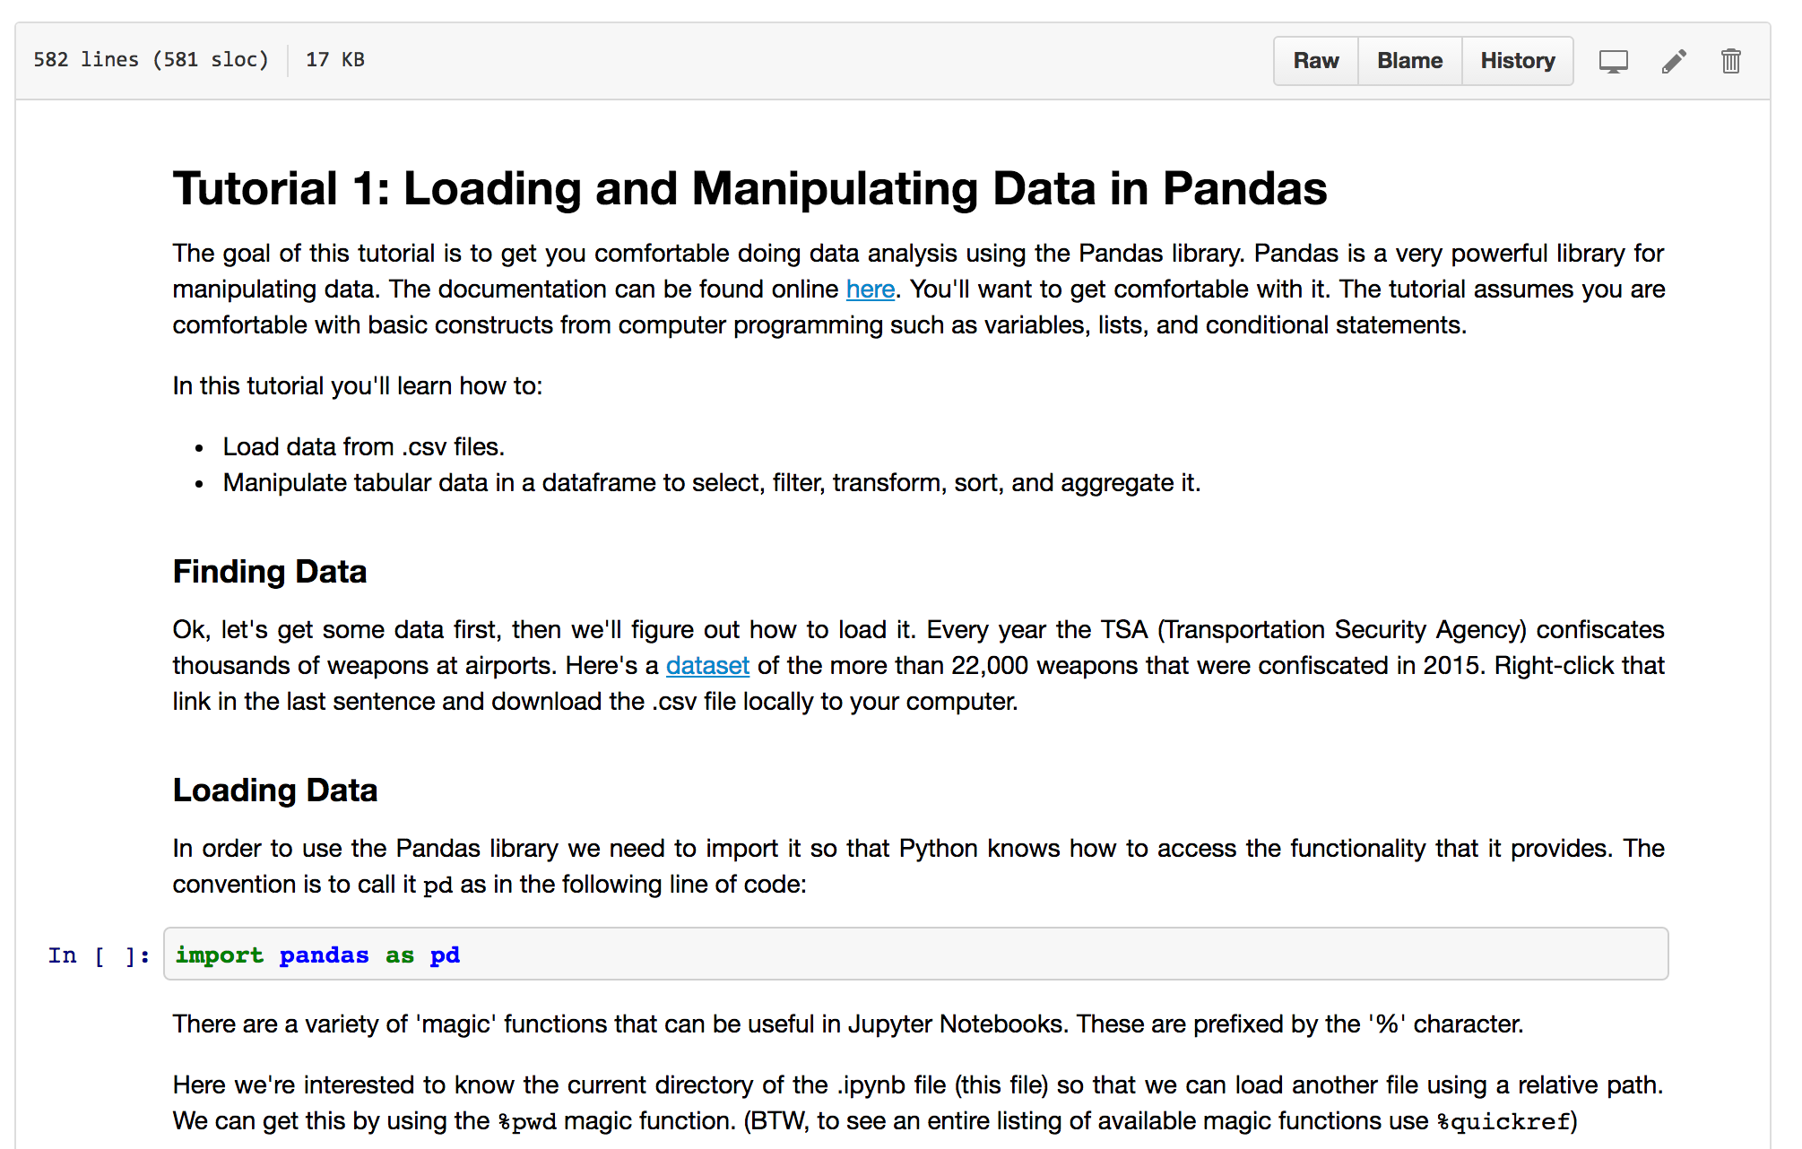

Slide 15
Code Circle
Don’t forget to RSVP for
the Coding Circle
Wed, 2/8, 4:30-7pm in Knight 3207

